Slide 1




SyriaTel Churn Analysis
AUTHOR: ROSE KYALO

Slide 2
Agenda:
 | Introduction
 | Objectives
 | Visualizations
 | Final Model
 | Conclusion
 | Recommendations
1
2
3
4
5
6

Slide 3
Introduction
1
1
This project delves into a comprehensive study of customer data.
Our primary objectives are to understand, mitigate customer churn, and drive revenue growth.
In this presentation, we'll explore how this analysis enhances SyriaTel's competitive edge in the telecommunications industry.
Our central focus lies in predicting customer churn and uncovering the contributing factors.

Slide 4
Objectives
2
Identify factors that will reduce Churn Rate
Establish if Revenue affect churn rate
Find out on Price Plan effect on churn rate
Determine effect of Network Quality on churn rate
Determine factors affecting churn rate
2

Slide 5
Visualization
Tools: Bar Plot, Correlation matrix plot, Model Comparison table

Slide 6
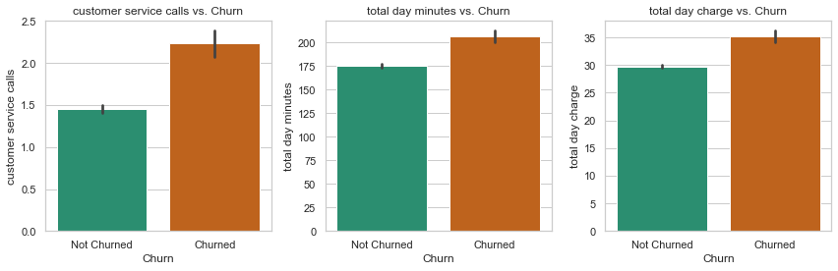
Bar plot
3
3

Slide 7
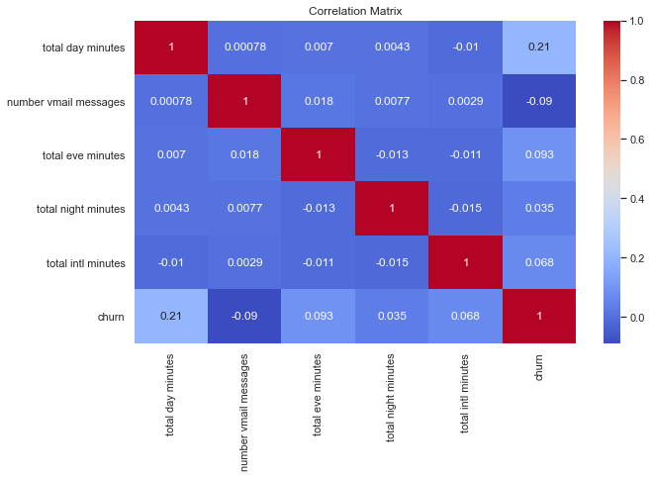
Correlation Matrix Plot
4
4
The correlation matrix reveals a strong positive relationship (compared to the other variables)between "total day minutes" and churn, indicating network quality issues during daytime usage.

Slide 8
Model comparison Table
5
Model | Best Hyperparameters | Accuracy | F1-Score (Churned) | F1-Score (Non - Churned)
Logistic Regression | {'C': 100, 'penalty': 'l2', 'solver': 'liblinear'} | 0.62 | 0.35 | 0.73
Decision Tree | {'Criterion': 'gini', 'Max Depth': 5, 'Random State': 42} | 0.70 | 0.39 | 0.80
Bagging Classifier | {'estimator__max_depth': 15, 'max_features': 1.0, 'max_samples': 1.0, 'n_estimators': 30} | 0.79 | 0.44 | 0.87
Random Forest | {'max_depth': 15, 'min_samples_leaf': 1, 'min_samples_split': 2, 'n_estimators': 30} | 0.78 | 0.43 | 0.86
XGBoost | {'learning_rate': 0.1, 'max_depth': 7, 'n_estimators': 200} | 0.83 | 0.47 | 0.90
5

Slide 9
Final Model
6
6
XGBoost-based machine learning model
It exhibited strong performance in identifying potential churners.
Our model evaluation focused on two key metrics: accuracy and f1 score.
Classification Report | Precision | Recall | F1-score | Accuracy(Cross Val Score)
False(Non-Churned) | 0.91 | 0.89 | 0.90 | 0.87
True(Churned) | 0.45 | 0.50 | 0.47

Slide 10
Conclusion
7
7
Customers who churn typically have a higher number of service calls, indicating dissatisfaction and the need for more support.
Churn is positively correlated with higher daytime call minutes, hinting at potential network quality issues during the day.
Churned customers tend to have higher daytime charges, suggesting pricing strategies may affect retention.
The XGBoost classifier, with optimized hyperparameters, is our top model for predicting churn risk.

Slide 11
Recommendations
Enhance the quality of customer service to reduce churn rates.
Strike a balance between retaining customers and ensuring profitability.
Focus on network improvements during the day for better service quality.
Continuously monitor and apply the model to identify and retain at-risk customers.

Slide 12
Research Presentation End
Thank you!
Notes:
You can use this slide as your opening or closing slide. Should you choose to use it as a closing, make sure you review the main points of your presentation. One creative way to do that is by adding animations to the various graphics on a slide. This slide has 4 different graphics, and, when you view the slideshow, you will see that you can click to reveal the next graphic. Similarly, as you review the main topics in your presentation, you may want each point to show up when you are addressing that topic.
Add animation to images and graphics:
Select your image or graphic.
Click on the Animations tab.
Choose from the options. The animation for this slide is “Split”. The drop-down menu in the Animation section gives even more animations you can use.
If you have multiple graphics or images, you will see a number appear next to it that notes the order of the animations.
Note: You will want to choose the animations carefully. You do not want to make your audience dizzy from your presentation.

